Slide 1

Phishing Site Detection
Batch No: CSI-15
Project members:
Akanksha Agarwal
Vaishnavi BaluReddy
Navya Dandu
Guided By:
Rupak reddy

Slide 2
Slide Map
Abstract
Terminology Used
Existing System
Block Diagram
Proposed System
System Architecture
Project Description
System Requirements
Advantages
Implementation
Results
Conclusion
References
www.techionary.info

Slide 3
Abstract
We developed a full-stack web application using Django and deployed a Machine Learning model for Phishing site detection. Our application prompts the user to enter a site URL and detects whether the given URL is phished or not. We achieved an accuracy of 89.9% by using Support Vector Machine with Polynomial Kernel algorithm. We do predictions based on features like the total length of the URL, the number of subdomains in the URL, and the presence of an IP address. We incorporated a Python Virtual Environment and created the Model-View-Controller software. Our project aims at providing a simple, user-friendly web-based tool to detect malicious URLs in order to implement Cyber Security.
www.techionary.info

Slide 4
Terminology Used
Machine Learning
Support Vector Machine Algorithm
Feature Selection
Django framework
Model-View-Controller software
Python
Virtual Environment
www.techionary.info

Slide 5
Existing System
A phishing website tries to steal account passwords or other confidential information by tricking the user into believing that it is a legitimate website. Most of the existing systems either fails to provide a high accuracy rate in order to trust the prediction or do not offer a secure, scalable user interface that could run without any existing infrastructure. The traditional blacklist approach and the heuristic evaluation of the source code to check for attributes commonly associated with phishing sites is often time-consuming and monotonous.
www.techionary.info

Slide 6
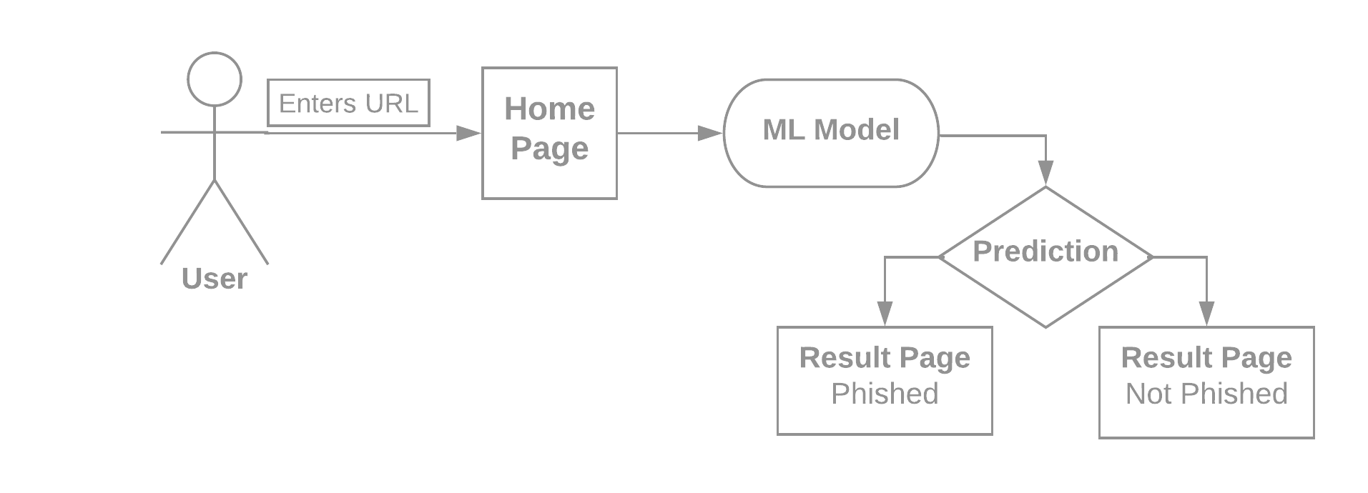
Block Diagram
www.techionary.info

Slide 7
Proposed System
We propose to use machine learning to overcome the drawbacks associated with the traditional approaches to phishing detection. The problem of phishing detection is an ideal candidate for the application of machine learning solutions because of the easy availability of sufficient amounts of data on phishing attack patterns. The basic idea is to use machine learning algorithms on an available dataset of phishing pages to generate a model which can be used to make classifications in real-time if a given web page is a phishing page or a legitimate webpage. We intend to productionize the learned model into a software tool that can be deployed easily to end-users for combating phishing attempts. For this purpose, we have chosen to implement a SVM algorithm from scratch using the Django framework.
www.techionary.info

Slide 8
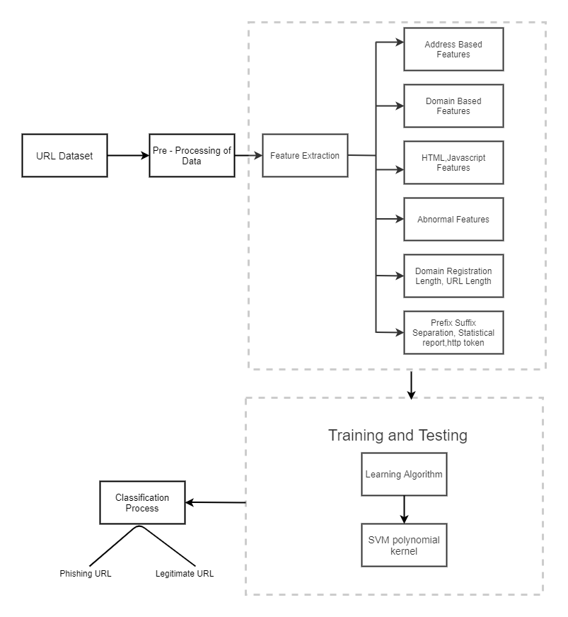
System
Architecture
www.techionary.info

Slide 9
Project Description
Our project aims at providing a simple, user-friendly web-based tool to detect malicious URLs in order to implement Cyber Security by showing a use-case of detecting phishing websites using machine learning and a phishing website detection software is developed. All of URLs in the dataset are labelled. We used supervised learning algorithm support vector machine to train using scikit-learn library. The user only has to enter the URL and submit it which in turn gives them the response if it’s a phishing website or not. For the application to be easily accessible by anybody, the user only needs to have an internet connection and a URL to be tested. The goal with such few requirements is make sure that everyone can conveniently use the product and stay risk free from phishing attacks.
www.techionary.info

Slide 10
System Requirements
The detection website consists of a designated space to enter a URL.
The user only has to enter the URL and submit it which in turn gives them the response if it’s a phishing website or not.
For the application to be easily accessible by anybody, the user only needs to have an internet connection and a URL to be tested.
www.techionary.info

Slide 11
Advantages
The first and foremost benefit of phishing simulation is the decreased security risks to the system, organization due to social engineering attacks involving human manipulation and deception.
The purpose of which is to mimic a legitimate website such as online banking, e-commerce or social networking website in order to obtain sensitive data such as user-names, passwords, financial and health-related information from potential victims.
According to a trusted source, 79% of phishing attacks are blocked by URL verification.
Open ID decreases the detection times of phishing attacks.
www.techionary.info

Slide 12
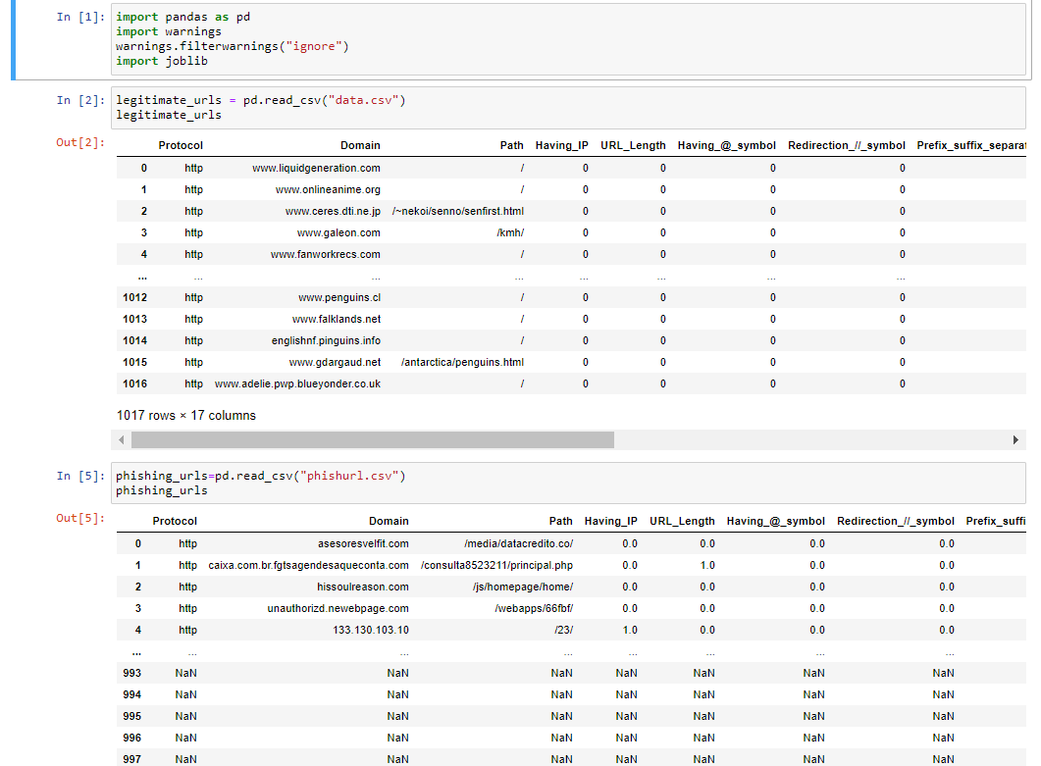
1. Datasets of legitimate websites and phished websites are taken
Implementation

Slide 13
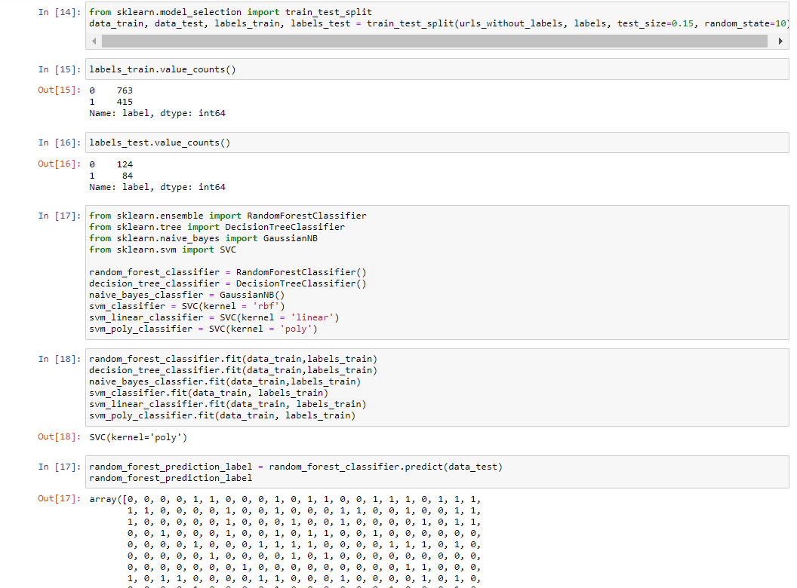
2. Developing a Machine Learning Model
www.techionary.info

Slide 14
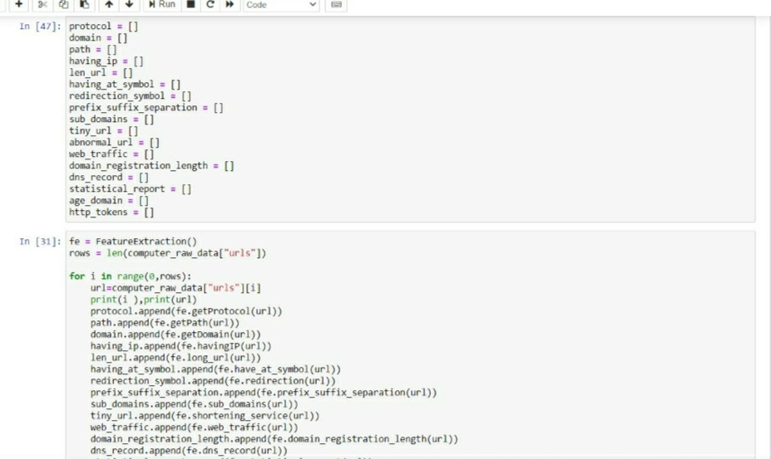
3. Feature selection is applied to datasets.

Slide 15
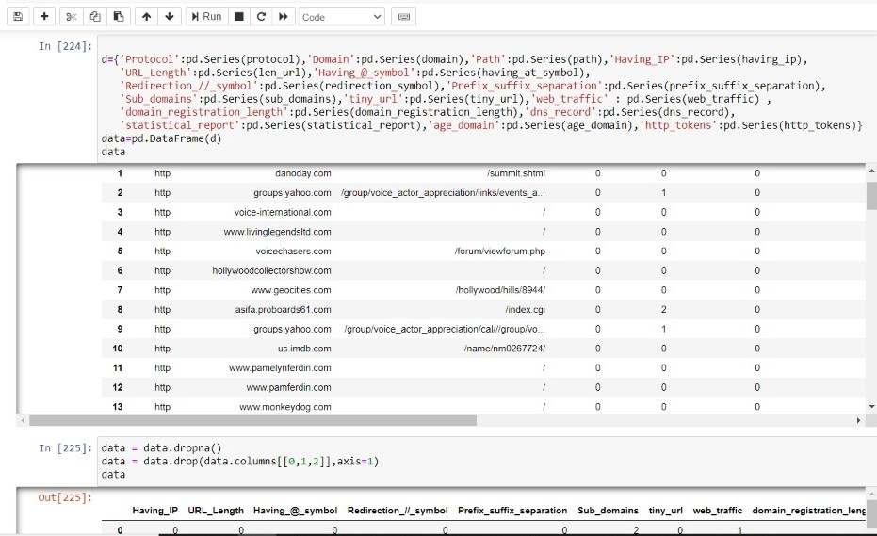

Slide 16
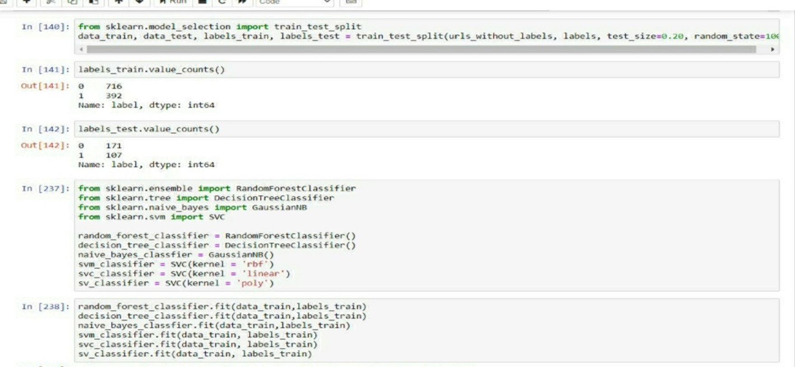
4. The machine learning model is trained with Support Vector Machine classifier.

Slide 17
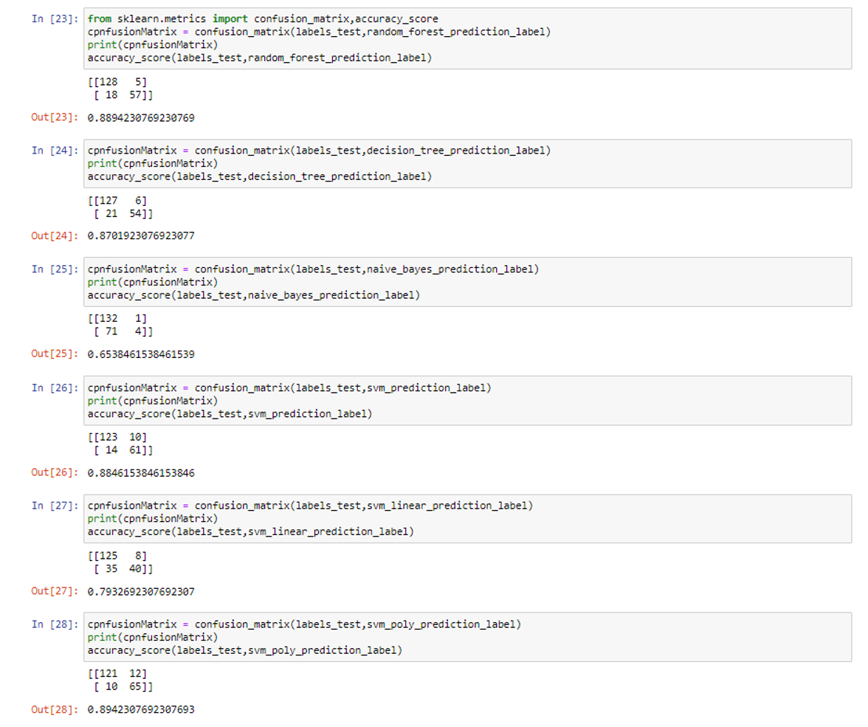
5. Storing this in prediction label to show the accuracy for all ML models

Slide 18
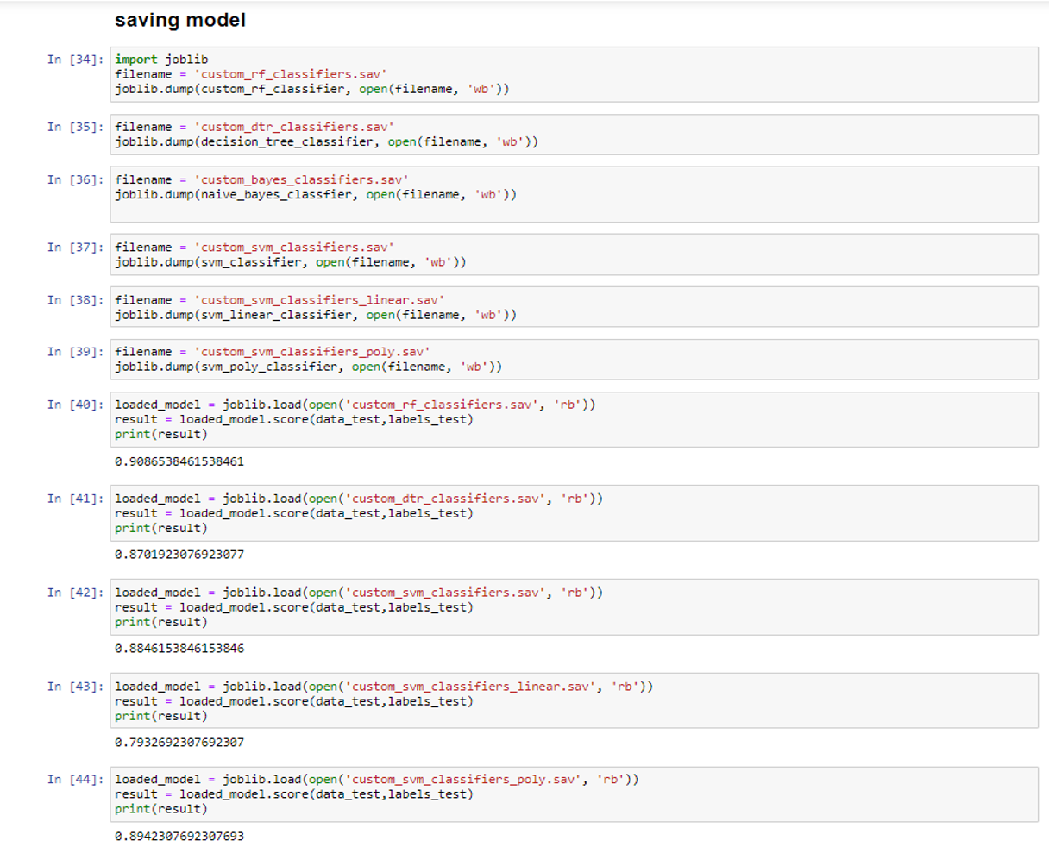
6. Saving the model

Slide 19
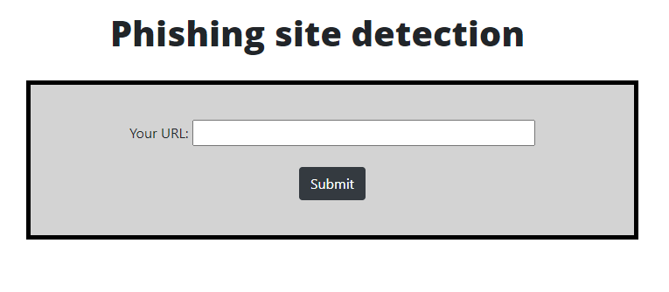
Results
This is the final result in the browser after running the server where the user needs to give the input as a URL.
www.techionary.info

Slide 20
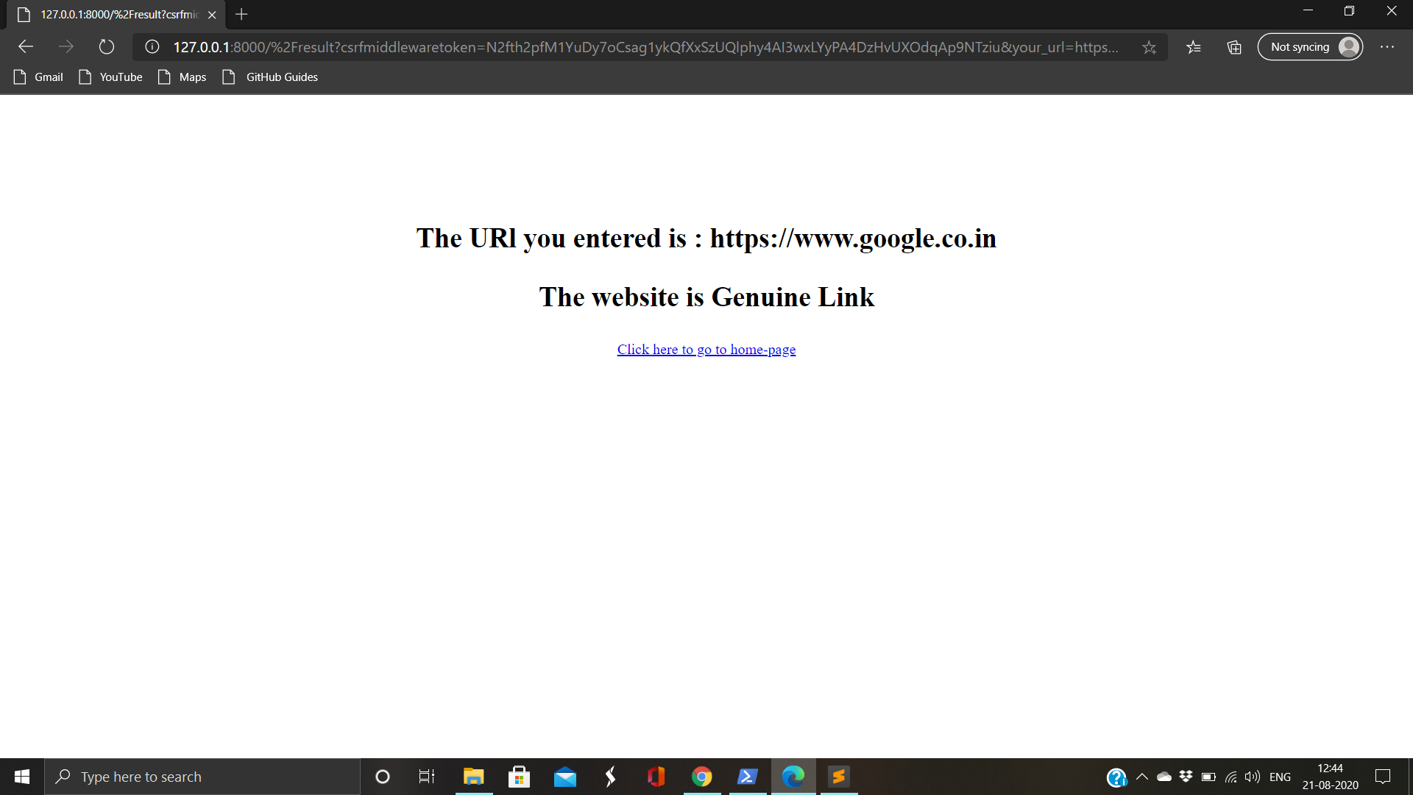
After you enter submit, it is redirected to result page and displays whether the given site is phished or a genuine one.

Slide 21
Conclusion
At the end of the project we were able to achieve a dynamic, secure and scalable web application to prevent phishing attacks. Support Vector Machine, Machine Learning Algorithm was deployed on the web application built using the Django framework. We were able to develop a user-friendly software where the users can find out if a given website is phished or not with just a click of a button hence keeping them safe and preventing Cyber-Attacks.
www.techionary.info

Slide 22
References
https://archive.ics.uci.edu/ml/datasets/Phishing+Websites
https://medium.com/intel-software-innovators/detecting-phishing-websites-using-machine-learning-de723bf2f946
https://link.springer.com/article/10.1007/s12652-019-01311-4
https://www.metacompliance.com/blog/5-ways-to-identify-a-phishing-website/
https://towardsdatascience.com/phishing-domain-detection-with-ml-5be9c99293e5
www.oreilly.com/library/view/machine-learning-and/9781491979891/ch04.html
https://zeltser.com/build-malware-analysis-toolkit/
https://www.mlq.ai/django-machine-learning/
https://www.irjet.net/archives/V7/i3/IRJET-V7I3115.pdf
www.techionary.info

